Slide 1
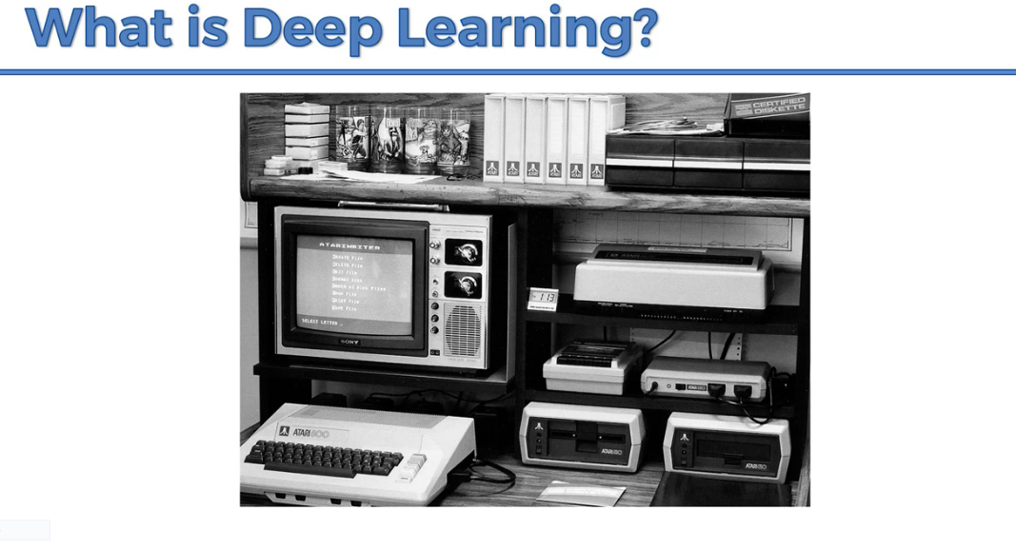
This clip has taken in 1994.
Neural network along with deep learning have been around for quite sometime.

Slide 2
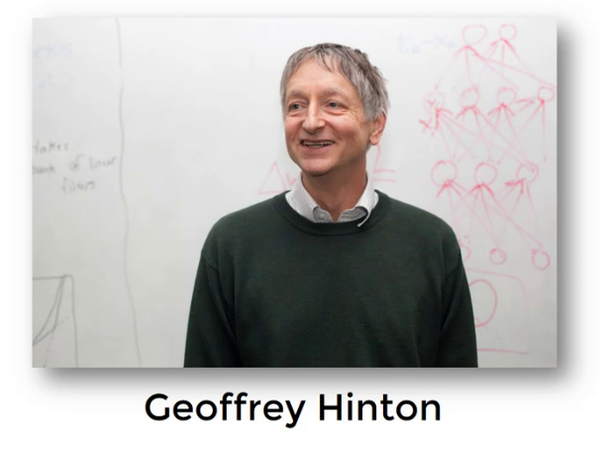
He is the father of deep learning
The idea behind deep learning is human brain
To build neural networks we need lot of data and processing power

Slide 3
Artificial Intelligence & Machine Learning
What is Artificial Intelligence(AI)?
Its just a technique that enables the machines to act like humans by replicating their behavior and nature.
Artificial Intelligence
What is Machine Learning?
Machine Learning
Machine Learning is a subset of AI which enables the computer to act and make data-driven decisions to carry out a certain task. We use a machine algorithm to parse data, learn from that data, and make informed decisions based on what it has learned.
Deep
Learning
What is Deep Learning?
Deep Learning is used in layers to create an Artificial Neural Network that can learn and make intelligent decisions on its own

Slide 4
Limitations of Machine Learning
It cannot handle huge amount of data
The challenge in Machine Learning is a feature Extraction
Complex problems such as object Recognition or hand writing recognition this
Is a huge challenge.
we had N-gram Language models, but again, the best thing could have been to capture the entire previous context (rather than last N words) for predicting the next word. With, RNNs, things have changed.

Slide 5
When to use Deep Learning or not over others?
Deep Learning out perform other techniques if the data size is large. But with small data size, traditional Machine Learning algorithms are preferable.
Deep Learning techniques need to have high end infrastructure to train in reasonable time.
When there is lack of domain understanding for feature introspection,Deep Learning techniques outshines others as you have to worry less about feature engineering.
Deep Learning really shines when it comes to complex problems such as image classification, natural language processing, and speech recognition.

Slide 6
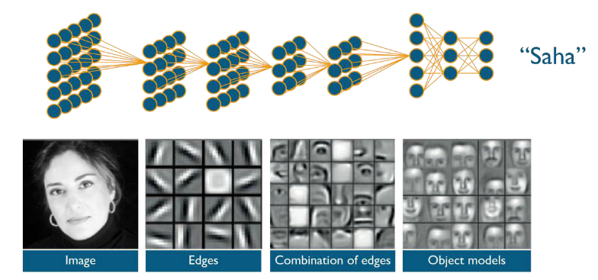
How deep learning solves it?

Slide 7
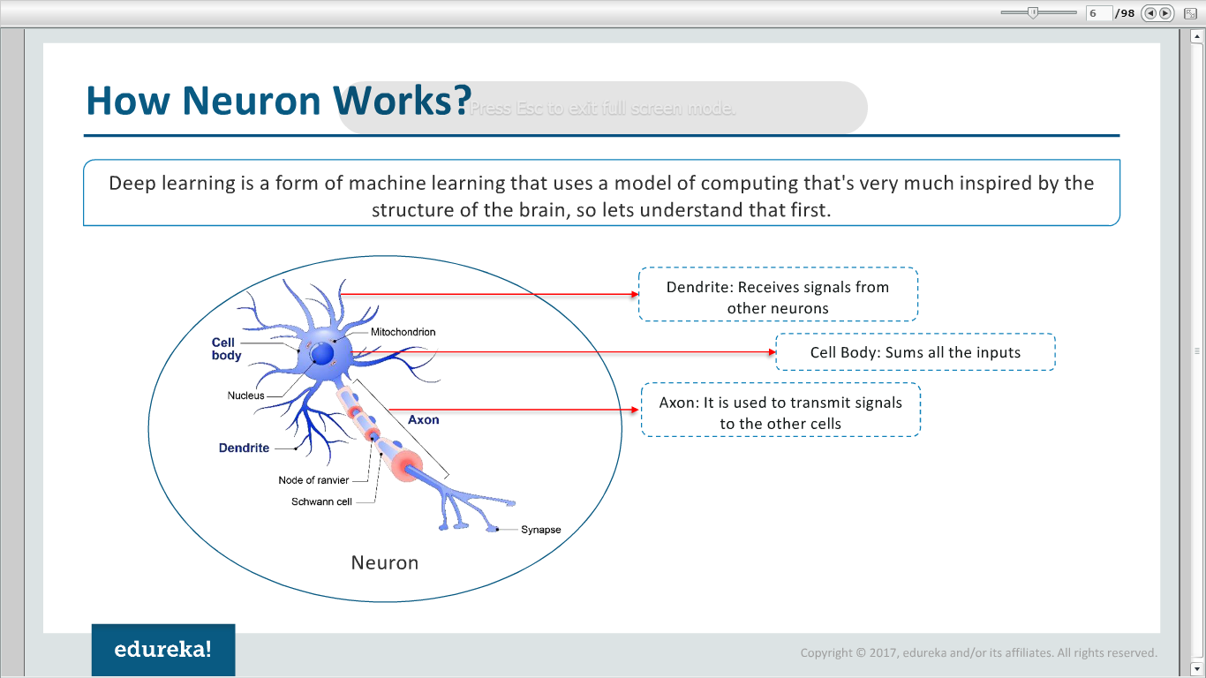
Biological Neuron

Slide 8
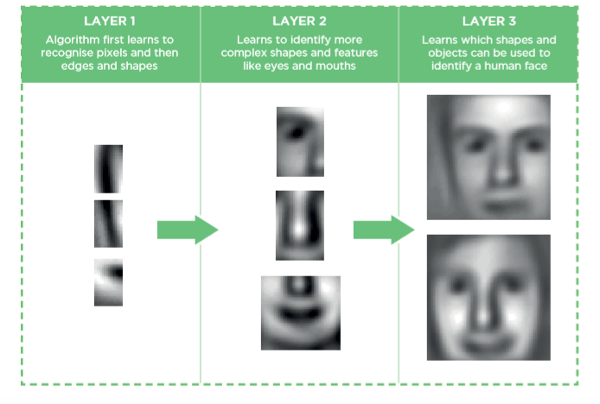
Deep Learning Architecture

Slide 9
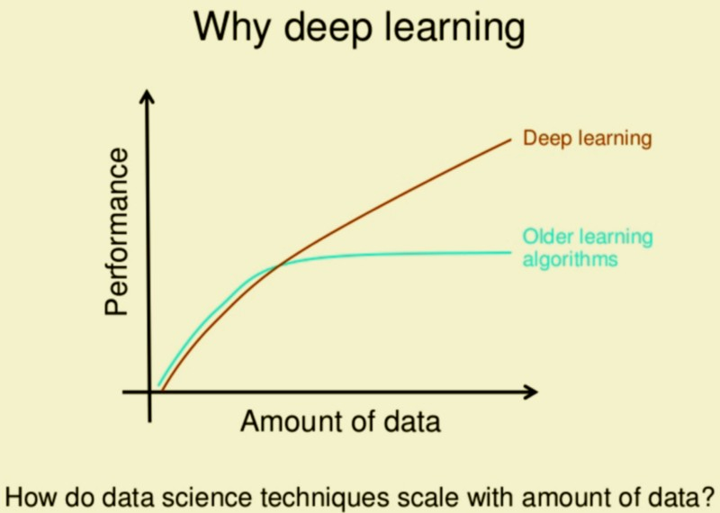

Slide 10
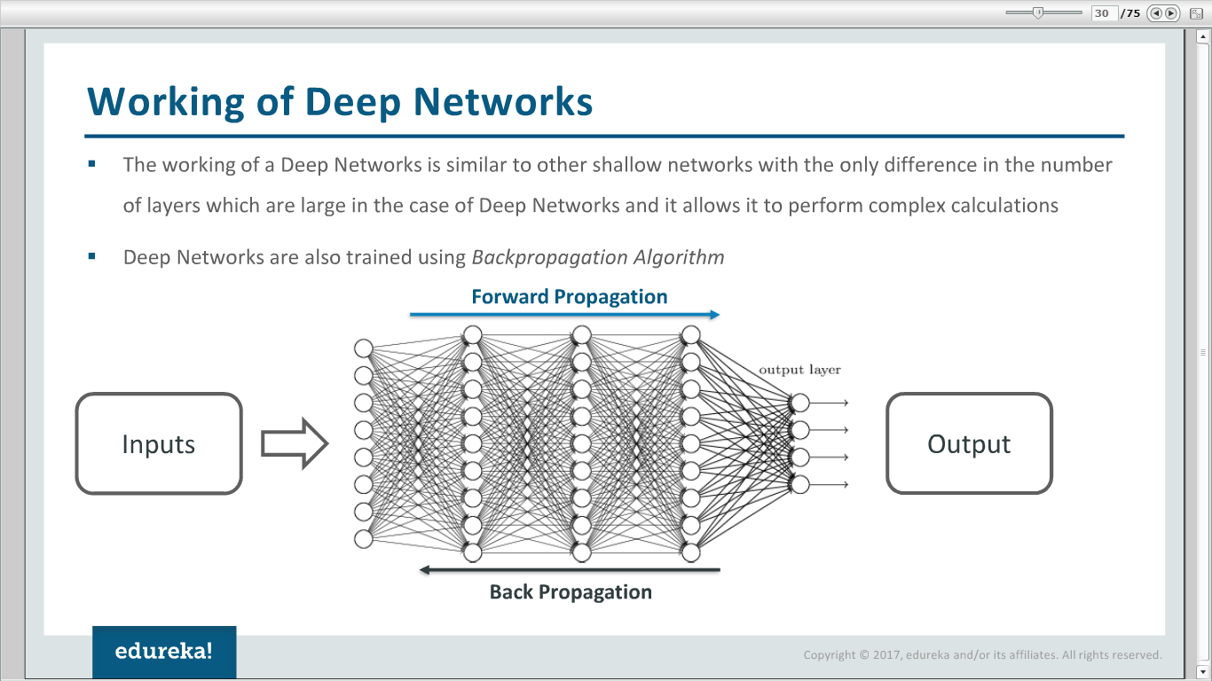
Deep Learning Architecture

Slide 11
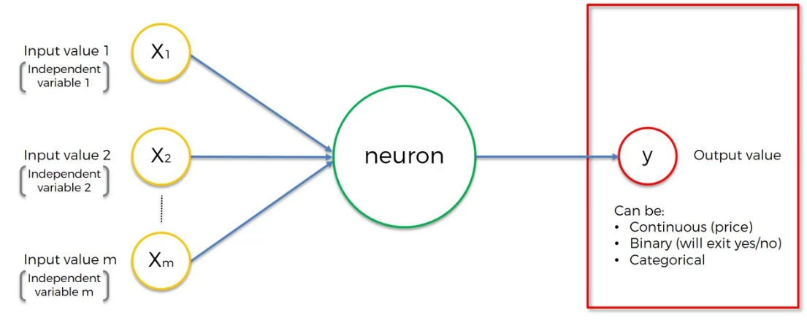
Artificial Neural Network

Slide 12
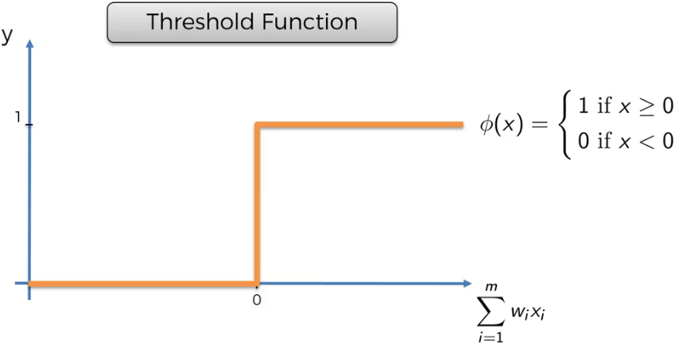
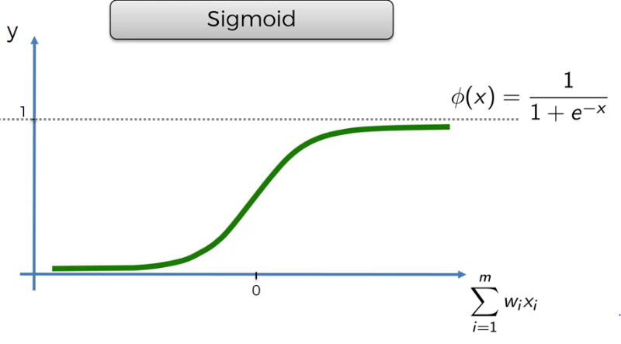
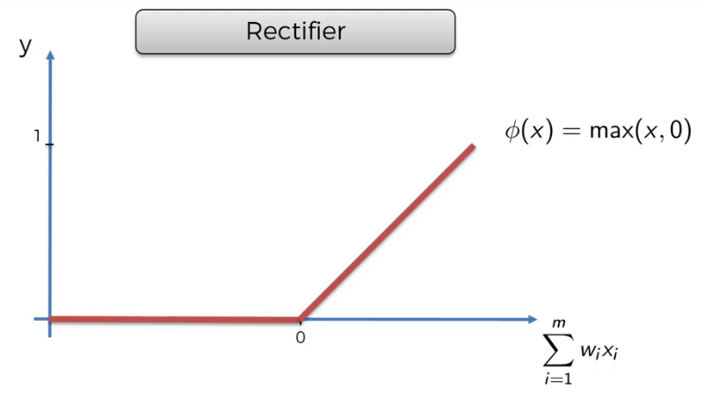
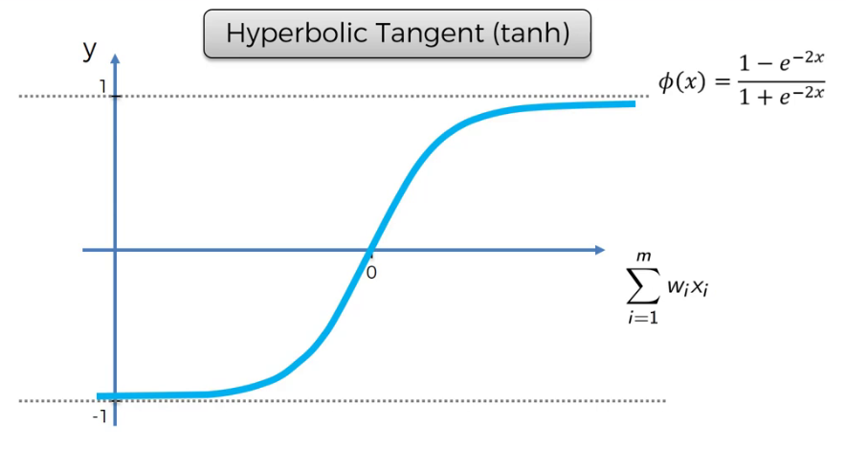
Activation Functions

Slide 13
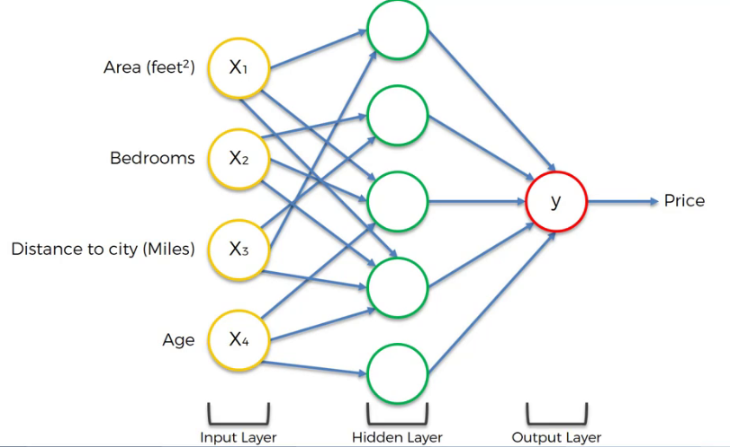
How do Neural Networks work?

Slide 14

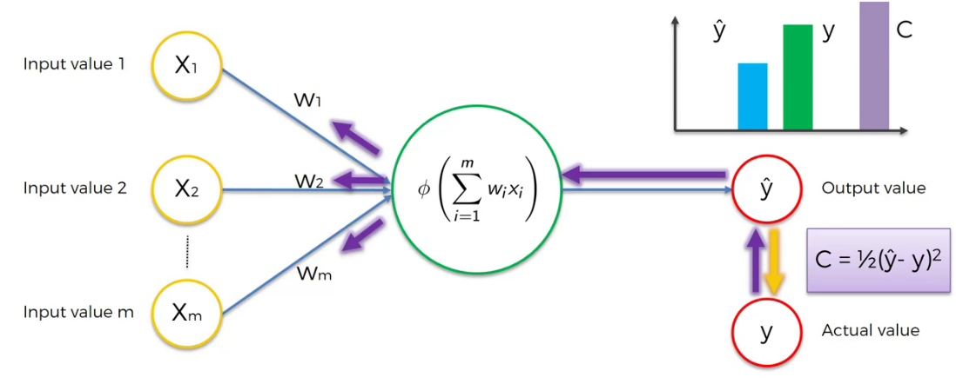
How do Neural Networks Learn?

Slide 15
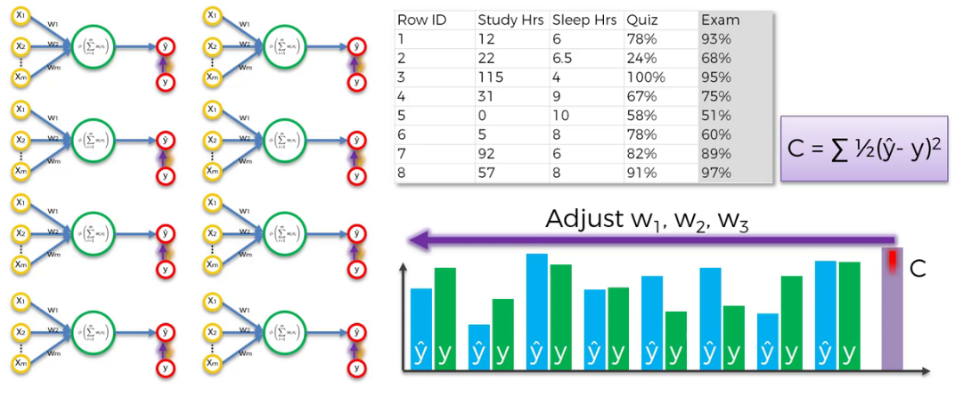

Slide 16

Optimization - 1

Slide 17

Optimization - 2

Slide 18
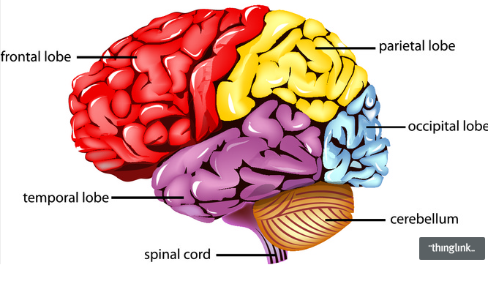

Slide 19
Output Layer
Hidden Layer
Input Layer

Slide 20
Output Layer
Output Layer
Hidden Layer
RNN Layer
Input Layer
Input Layer

Slide 21
=
…
Time

Slide 22
…
…
…
Time

Slide 23
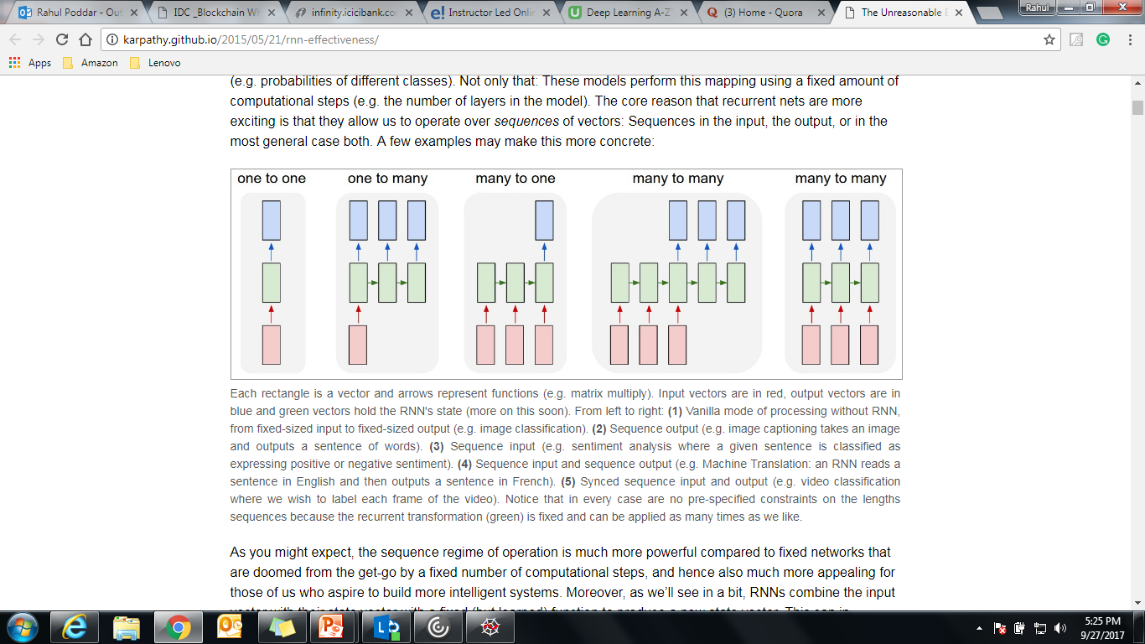

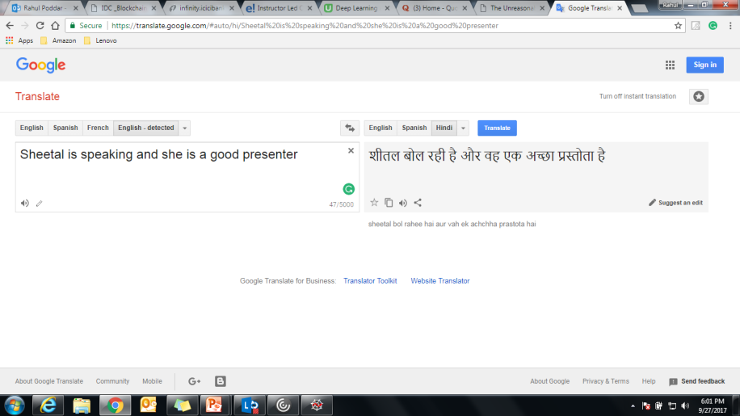

RNN - Applications
A horrified cat sitting under the table
Cat
Positive
I had an excellent stay at the hotel!!
Ref: http://karpathy.github.io/2015/05/21/rnn-effectiveness/

Slide 24
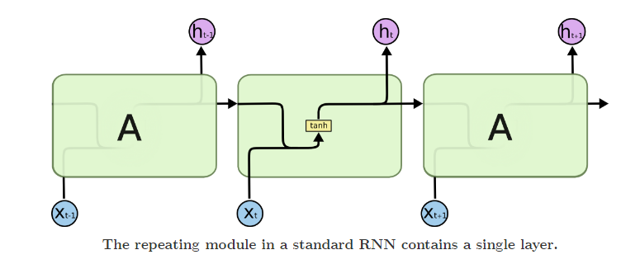
http://colah.github.io/posts/2015-08-Understanding-LSTMs/

Slide 25
Vanishing & Exploding Gradients
E0
E1
E2
E3
δE3/δS3
δS1/δS0
δS2/δS1
δS3/δS2
S0
S1
S2
S3
X0
X1
X2
X3
S3 = tanh(UX3 + WS2)

Slide 26
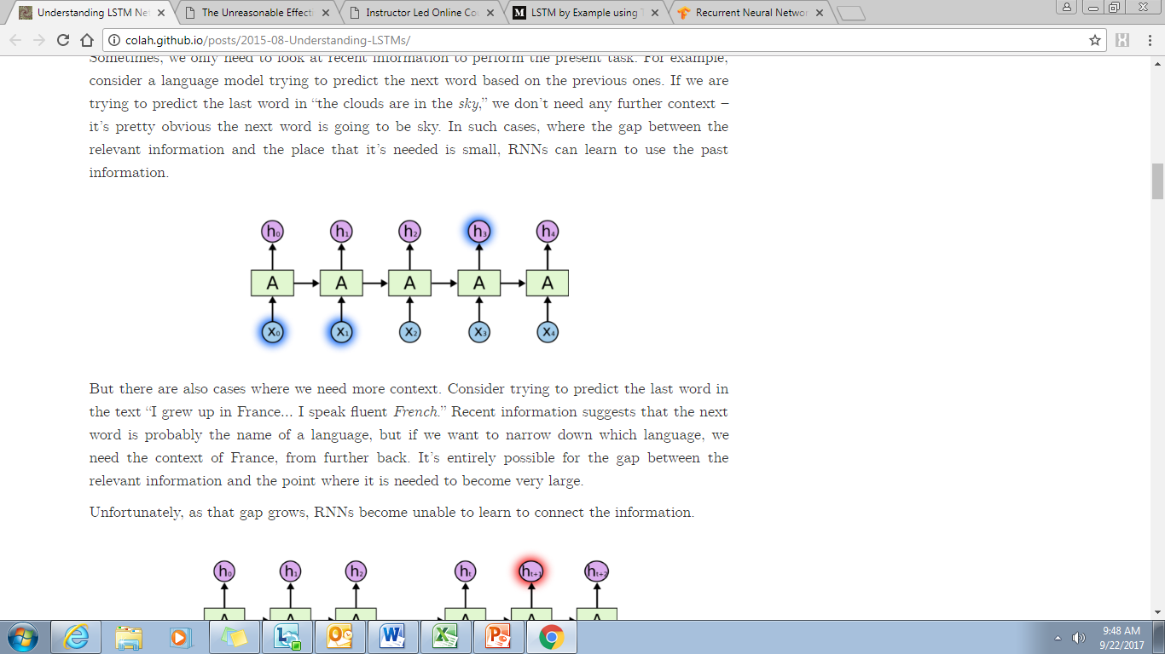
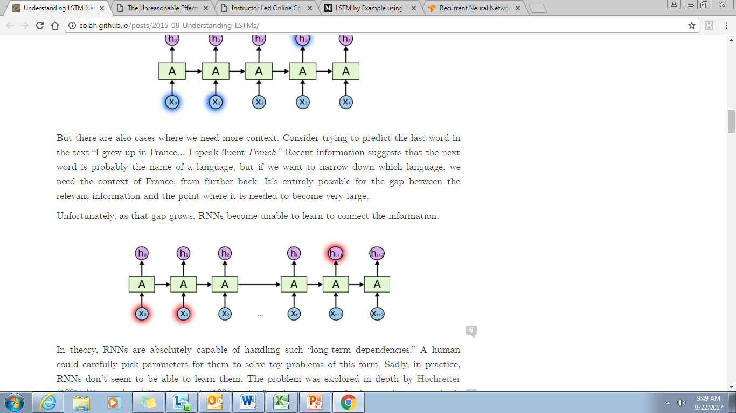
The clouds are in the sky
I grew up in France. I love to travel, I have travelled to several countries and I can speak fluent French

Slide 27
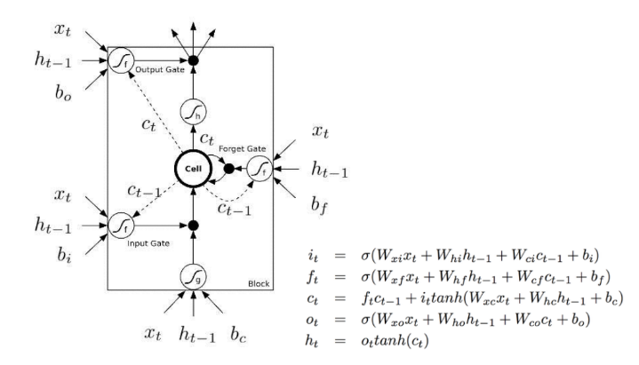
LSTM - Long Short Term Memory

Slide 28
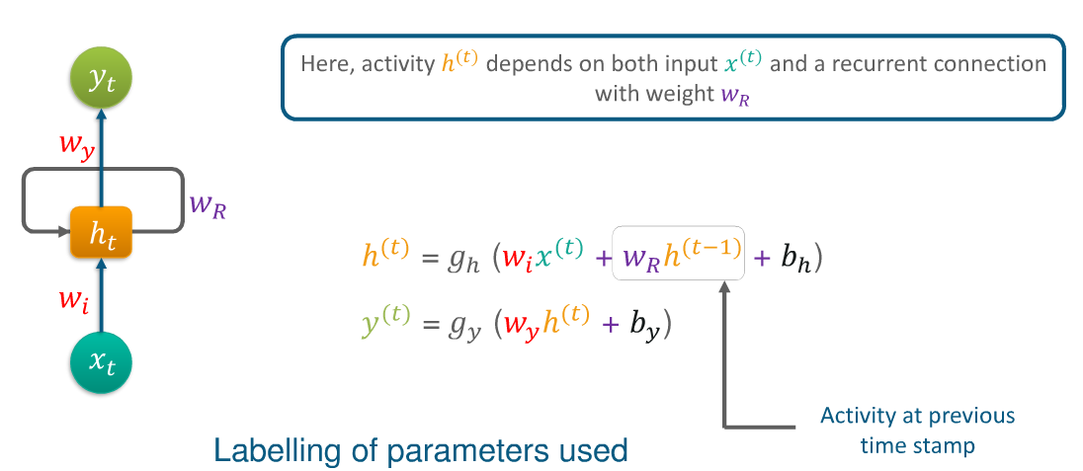
http://colah.github.io/posts/2015-08-Understanding-LSTMs/
http://karpathy.github.io/2015/05/21/rnn-effectiveness/

Slide 30
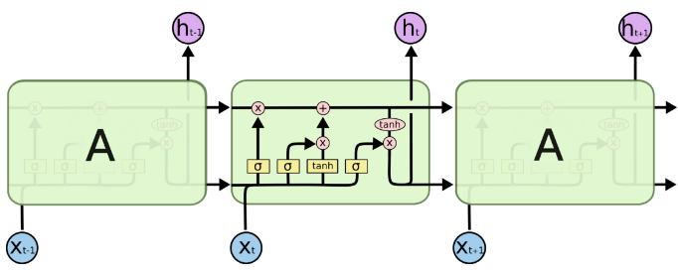

Slide 31
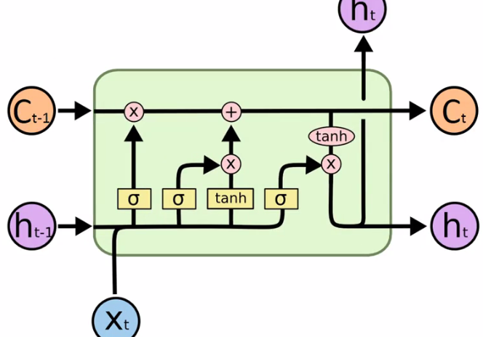

Slide 32
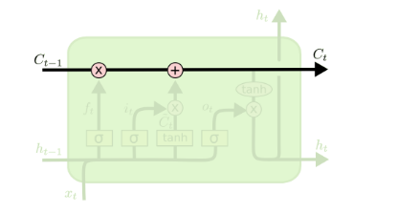
Ayyappa is taking a presentation. Ayyappa is explaining LSTMs. He understands LSTMs quite well

Slide 33



Slide 34
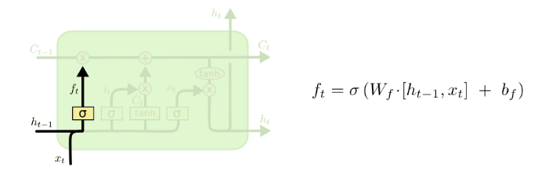
“Forget Gate ”
Ayyappa is taking a presentation. Ram, Ayyappa’s friend, ……

Slide 35
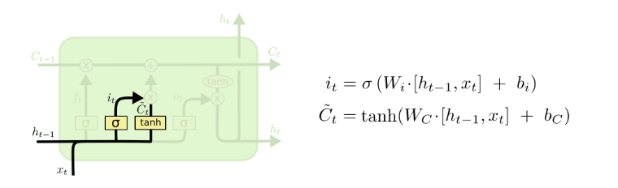
“Input Gate”
Rahul is taking a presentation. Ram, Rahul’s friend, is sleeping. He holds a PhD.

Slide 36
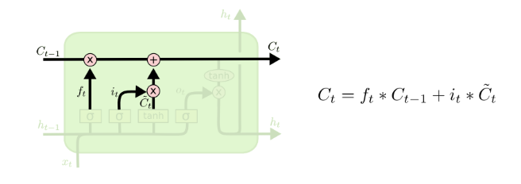

Slide 37
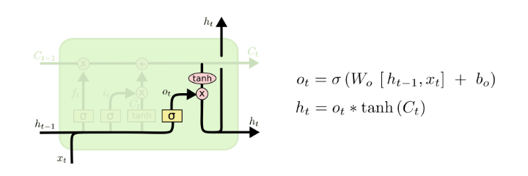
Ayyappa is taking a presentation. Ram, Ayyappa’s friend, is sleeping. He holds a MTech. They both are educated.

